Slide 1
Hierarchical clustering
Hongning Wang
CS@UVa

Slide 2
Today’s lecture
Hierarchical clustering algorithm
Bottom-up: agglomerative
Distance between clusters
Complexity analysis

Slide 3
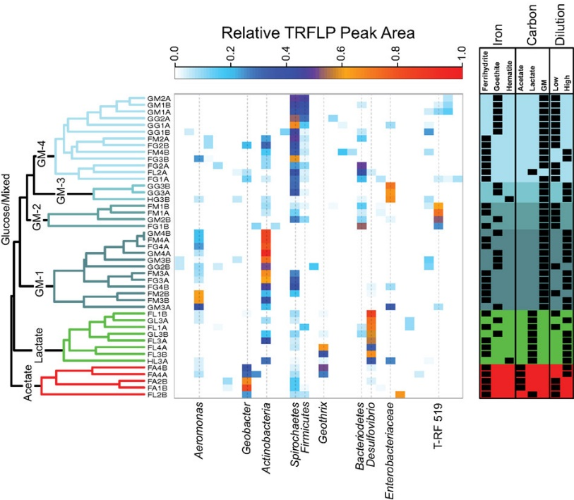
Hierarchical clustering
Build a tree-based hierarchical taxonomy from a set of instances
Dendrogram – a useful tool to summarize similarities
After cutting, each connected component will be a cluster

Slide 4







Agglomerative hierarchical clustering
Pairwise distance metric between instances
0 | 1 | 2 | 2 | 3 | 3 | 4
 | 0 | 2 | 2 | 3 | 3 | 4
 |  | 0 | 2 | 3 | 3 | 4
 |  |  | 0 | 3 | 4 | 4
 |  |  |  | 0 | 2 | 3
 |  |  |  |  | 0 | 2
 |  |  |  |  |  | 0

Slide 5
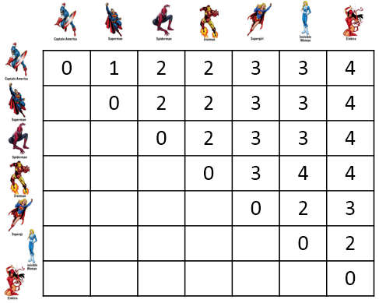
Agglomerative hierarchical clustering
Every instance is in its own cluster when initialized
Repeat until one cluster left
Find the best pair of clusters to merge and break the tie arbitrarily
Enumerate all the possibilities!
How to compare distance between an instance and a cluster of instances?
?

Slide 6
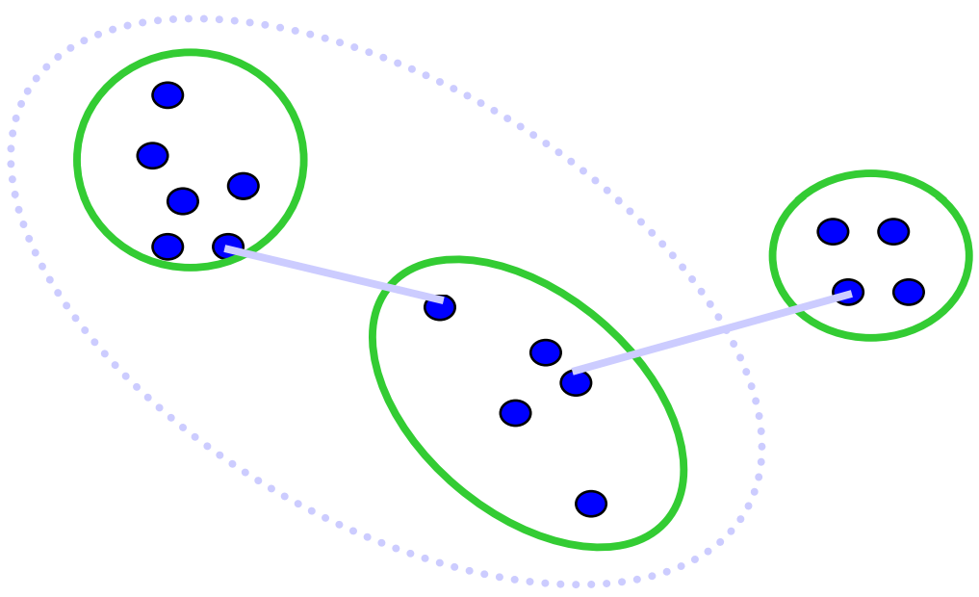
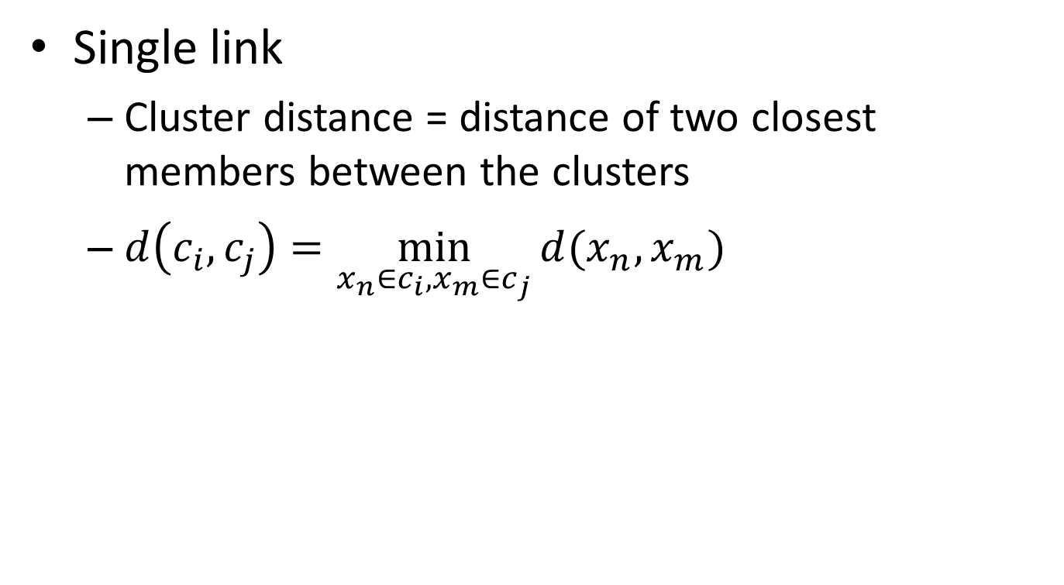
Distance measure between clusters
Single link
Cluster distance = distance of two closest members between the clusters
$d\left(c_{i},c_{j}\right)=\min_{x_{n}∈c_{i},x_{m}∈c_{j}}{d(x_{n},x_{m})}$
Tend to generate scattered clusters

Slide 7
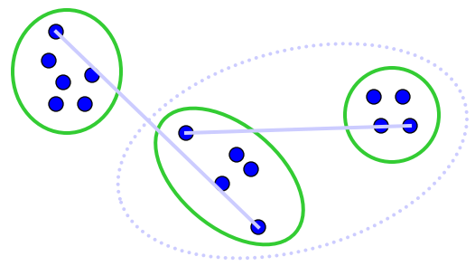
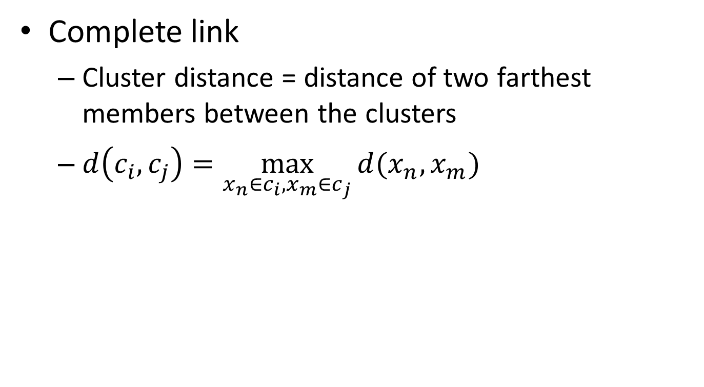
Distance measure between clusters
Complete link
Cluster distance = distance of two farthest members between the clusters
$d\left(c_{i},c_{j}\right)=\max_{x_{n}∈c_{i},x_{m}∈c_{j}}{d(x_{n},x_{m})}$
Tend to generate tight clusters

Slide 8
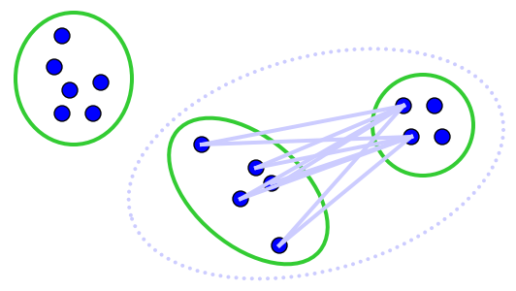
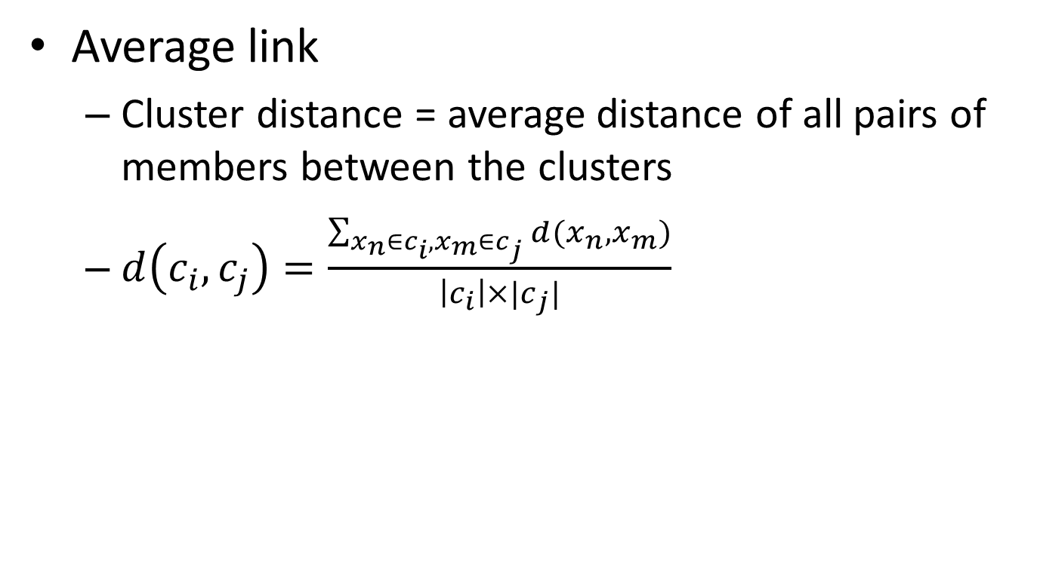
Distance measure between clusters
Average link
Cluster distance = average distance of all pairs of members between the clusters
$d\left(c_{i},c_{j}\right)=\frac{\sum_{x_{n}∈c_{i},x_{m}∈c_{j}}{d(x_{n},x_{m})}}{\left|c_{i}\right|×|c_{j}|}$
Mostly popularly used measure, robust against noise

Slide 9
Agglomerative hierarchical clustering
Every instance is in its own cluster when initialized
Repeat until one cluster left
Find the best pair of clusters to merge and break the tie arbitrarily

Slide 10
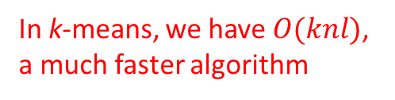
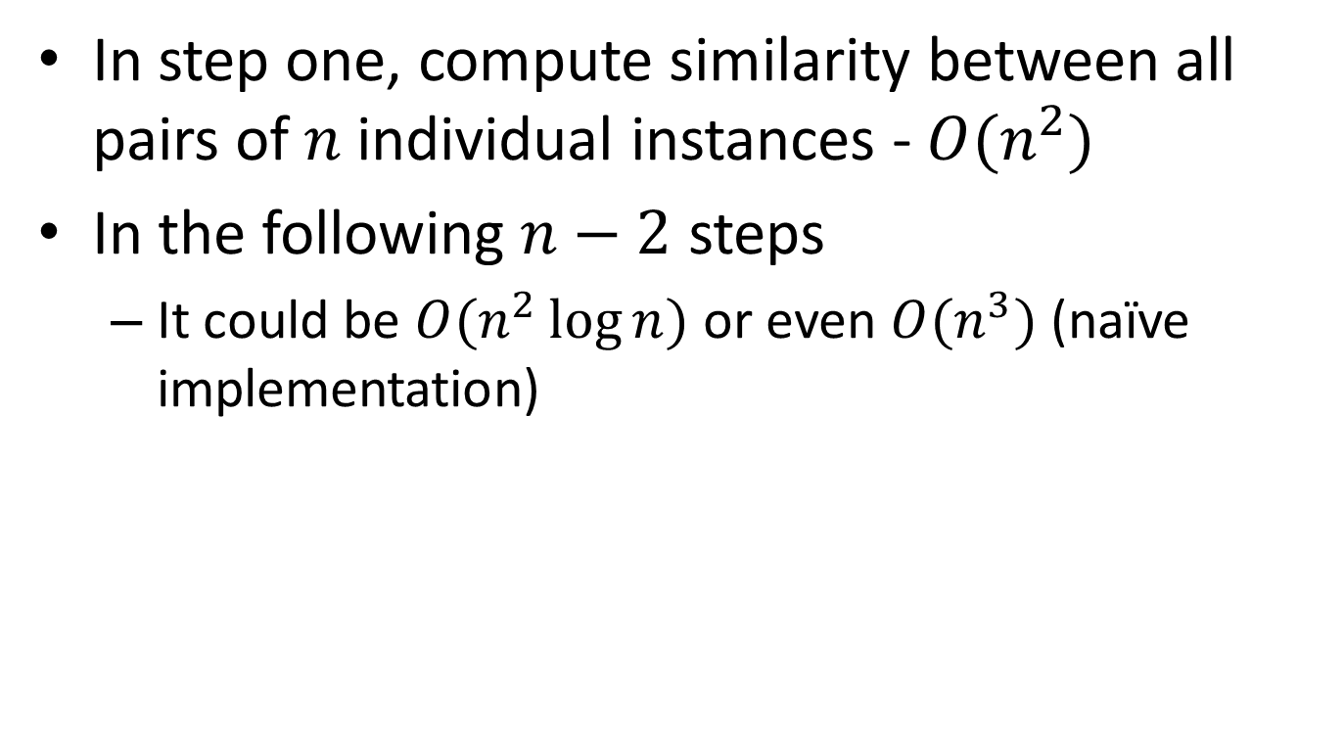
Complexity analysis
In step one, compute similarity between all pairs of $n$ individual instances - $O(n^{2})$
In the following $n−2$ steps
It could be $O(n^{2}\log{n})$ or even $O(n^{3})$ (naïve implementation)
In k-means, we have $O(knl)$, a much faster algorithm

Slide 11
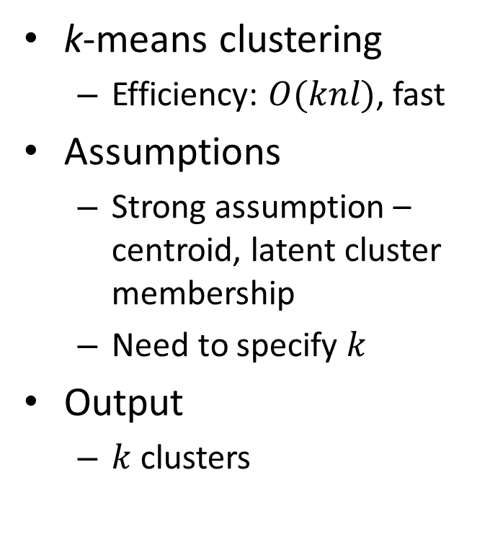
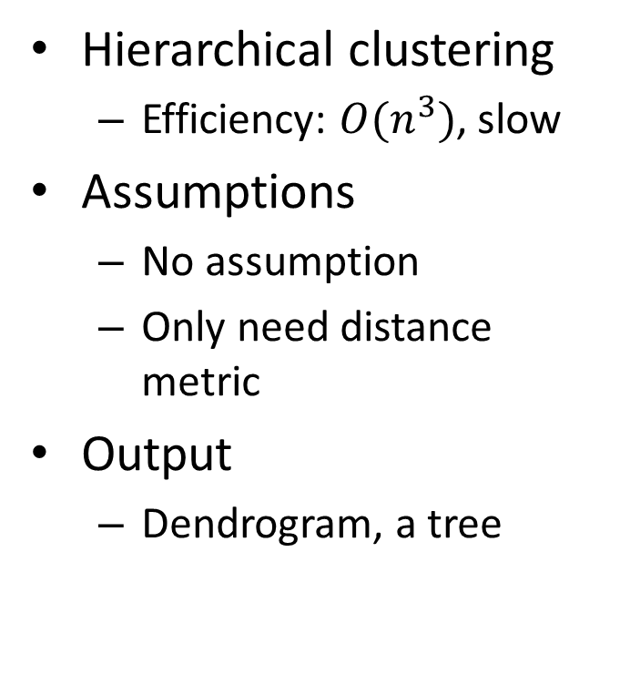
Comparisons
Hierarchical clustering
Efficiency: $O(n^{3})$, slow
Assumptions
No assumption
Only need distance metric
Output
Dendrogram, a tree
k-means clustering
Efficiency: $O(knl)$, fast
Assumptions
Strong assumption – centroid, latent cluster membership
Need to specify $k$
Output
$k$ clusters

Slide 12
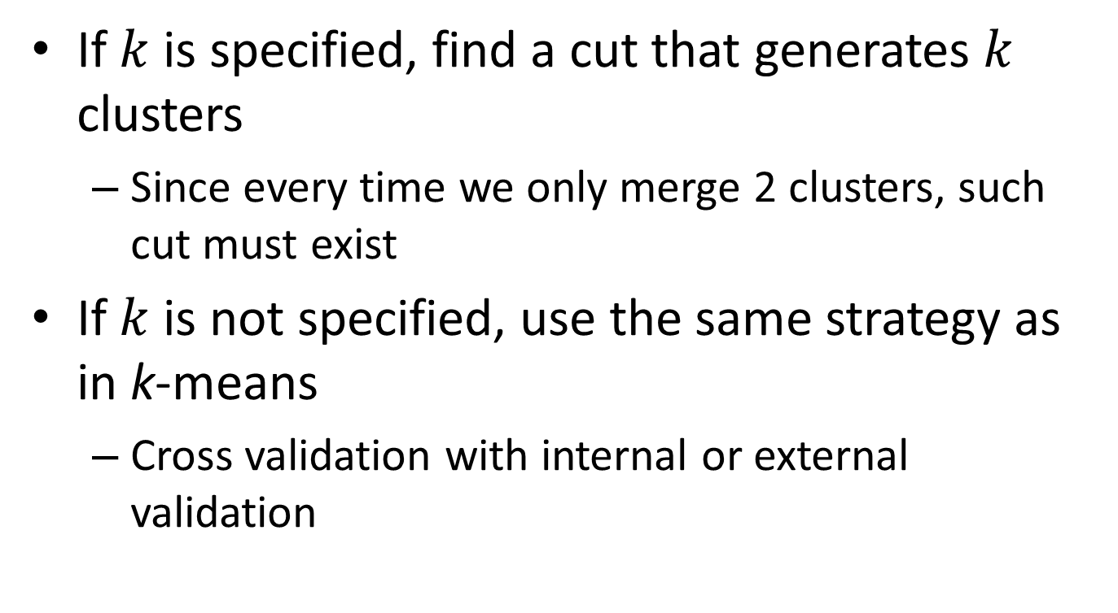
How to get final clusters?
If $k$ is specified, find a cut that generates $k$ clusters
Since every time we only merge 2 clusters, such cut must exist
If $k$ is not specified, use the same strategy as in k-means
Cross validation with internal or external validation

Slide 13
What you should know
Agglomerative hierarchical clustering
Three types of linkage function
Single link, complete link and average link
Comparison with k-means

Slide 14
Today’s reading
Introduction to Information Retrieval
Chapter 17: Hierarchical clustering
17.1 Hierarchical agglomerative clustering
17.2 Single-link and complete-link clustering
17.3 Group-average agglomerative clustering
17.5 Optimality of HAC

